Slide 1
Dashboard on employees of ABC Ltd
By
Shajan Reynold

Slide 2
The Data set
Data of employees by ABC ltd
Name | Gender | Hire date | Status | Hire Type | Department | Category | Qualification | Salary | Bonus | Overtime | Sick leaves | Rating -Performance | Rating-Behaviour | Innovation | collegues | Average rating | Promotion eligibility
Christopher Justin | Male | 42917 | Active | FTE | Marketing & Sales | Team Member | Master's Degree | 45000 | 6750 | 2250 | 1 | 5 | 5 | 5 | 5 | 5 | Eligible
Scott Jesse | Male | 42186 | Active | FTC | Marketing & Sales | Team Member | Master's Degree | 40000 | 0 | 2000 | 8 | 3 | 3 | 2 | 3 | 2.75 | Non Eligible
Justin Anthony | Male | 41640 | Active | FTE | Marketing & Sales | Team Member | Bachelor's Degree | 55000 | 5500 | 2750 | 0 | 3 | 5 | 5 | 4 | 4.25 | Eligible
Jerry Frank | Male | 42736 | Active | FTC | Marketing & Sales | Team Member | Master's Degree | 45000 | 6750 | 2250 | 0 | 5 | 5 | 5 | 5 | 5 | Eligible
Larry Nicholas | Male | 42614 | Active | FTE | Marketing & Sales | Team Member | Bachelor's Degree | 45000 | 4500 | 2250 | 3 | 5 | 5 | 5 | 2 | 4.25 | Eligible
Patrick Robert | Male | 42217 | Active | FTC | Marketing & Sales | Team Member | Master's Degree | 70000 | 7000 | 3500 | 7 | 3 | 4 | 5 | 4 | 4 | Non Eligible
Dylan Adam | Male | 41883 | Active | FTE | Marketing & Sales | Team Member | Bachelor's Degree | 45000 | 0 | 2250 | 6 | 3 | 3 | 2 | 3 | 2.75 | Non Eligible

Slide 3
Statements
Total number of employees
Count of Employees on basis of department
Employee hiring type
Status of employees
Employee designation (according to each category)
Expense on employee(salary ,bonus , overtime)
Expense on department
Average rating of behavior and performance in each department
Count of Eligible and non-eligible employees for promotion
Innovation Rating of each category

Slide 4
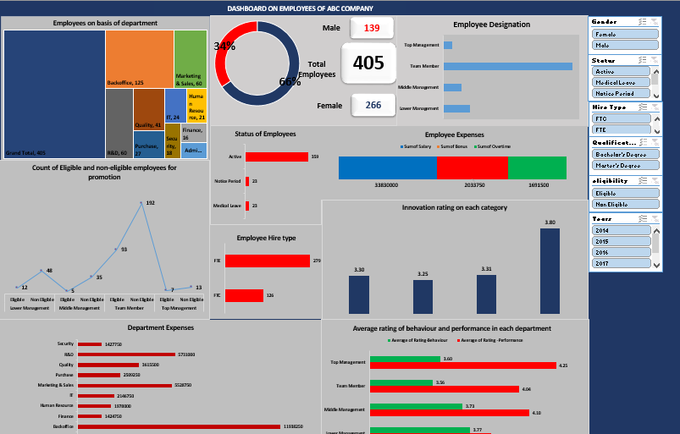
Dashboard

